Slide 1
Regression Analysis
Other Regression Methods
Nicoleta Serban, Ph.D.
Associate Professor
Stewart School of Industrial and Systems Engineering
Nonlinear & Nonparametric Regression

Slide 2
About this lesson

Slide 3
Multiple Linear Regression
Data: {(x₁₁,.., x_{1p}),Y₁},….,{(x_{n1},.., x_{np} ),Y_{n}}
Model: Y_{i} = β₀ + β₁x_{i1} + β₂x_{i2} +…+ β_{p}x_{ip} + ε_{i}, i =1,…,n
What if nonlinearity assumption does not hold?
If it does not hold for few quantitative predicting variables and transformation not known ⇒ Use transformations of the predicting variables to improve fit
If the relationship between response and the predicting variables is known ⇒ Use Nonlinear Regression
If it does not hold for many variables ⇒ Use Generalized Additive Regression
Assumptions:
Linearity/Mean Zero Assumption: E(ε_{i}) = 0
Constant Variance Assumption: Var(ε_{i}) = σ²
Independence Assumption: {ε₁,…, ε_{n}} are independent random variables
Normality Assumption: ε_{i} ~ Normal

Slide 4
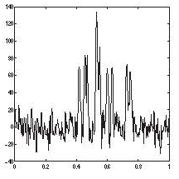


Example: Nonlinear Regression
Mass spectroscopy or NMR frequency data:
$$Y_{i}=\sum_{l=1}^{L}{\frac{A_{j}}{\frac{{\left(x_{i}−μ_{l}\right)}^{2}}{τ^{2}}+1}}+ε_{i}$$
Each peak corresponds to one component in the sum, with L different peaks;
Assume L is known;
Parameters:
  $μ_{l}$ for l=1,..,L which are the centers of the peaks
  $A_{l}$ for l=1,..,L which are the amplitudes of the peaks
Nonlinear Regression
The regression function has a known structure given the predicting variable(s); and
The regression function depends on a series of parameters.

Slide 5

Nonlinear Regression
Model Description:
Data: {(x₁₁,.., x_{1p}),Y₁},….,{(x_{n1},.., x_{np} ),Y_{n}}
Model: Y_{i} = f(x_{i1},…,x_{ip} |θ) + ε_{i}, i =1,…,n
f(x_{i1},…,x_{ip} |θ) known up to the parameter Vector: θ
Model Estimation:
Estimate by minimizing with respect to θ
$$\sum_{i=1}^{n}{{\left(Y_{i}−\text{f}\text{(}\text{xi}\text{1,…,}\text{xip}\text{|θ)}\right)}^{2}}$$
Apply numeric algorithms to obtain the estimate for θ
Nonlinear vs Linear Regression
Use least squares approach for estimation;
Assume same assumptions on the error terms hence goodness of fit can be performed similarly;
Regression function is nonlinear vs linear in the parameters;
Estimation of the parameters not in close form expression for nonlinear regression.
R software: nls() vs lm() ⇐ Nonlinear regression is more challenging to implement

Slide 6
Nonparametric Regression
Model Description:
Data: {(x₁₁,.., x_{1p}),Y₁},….,{(x_{n1},.., x_{np} ),Y_{n}}
Model: Y_{i} = f(x_{i1},…,x_{ip}) + ε_{i}, i =1,…,n
f(x_{i1},…,x_{ip}) unknown
Model Estimation:
Curse of dimensionality: To maintain a given degree of accuracy of an estimator, the sample size must increase exponentially with the dimension p.
  n = 30000 points when d = 5 to get the same accuracy as n = 300 when d = 1.
Nonparametric Regression
The regression function has an unknown structure given the predicting variable(s); and
The regression function does not depend on parameters.

Slide 7
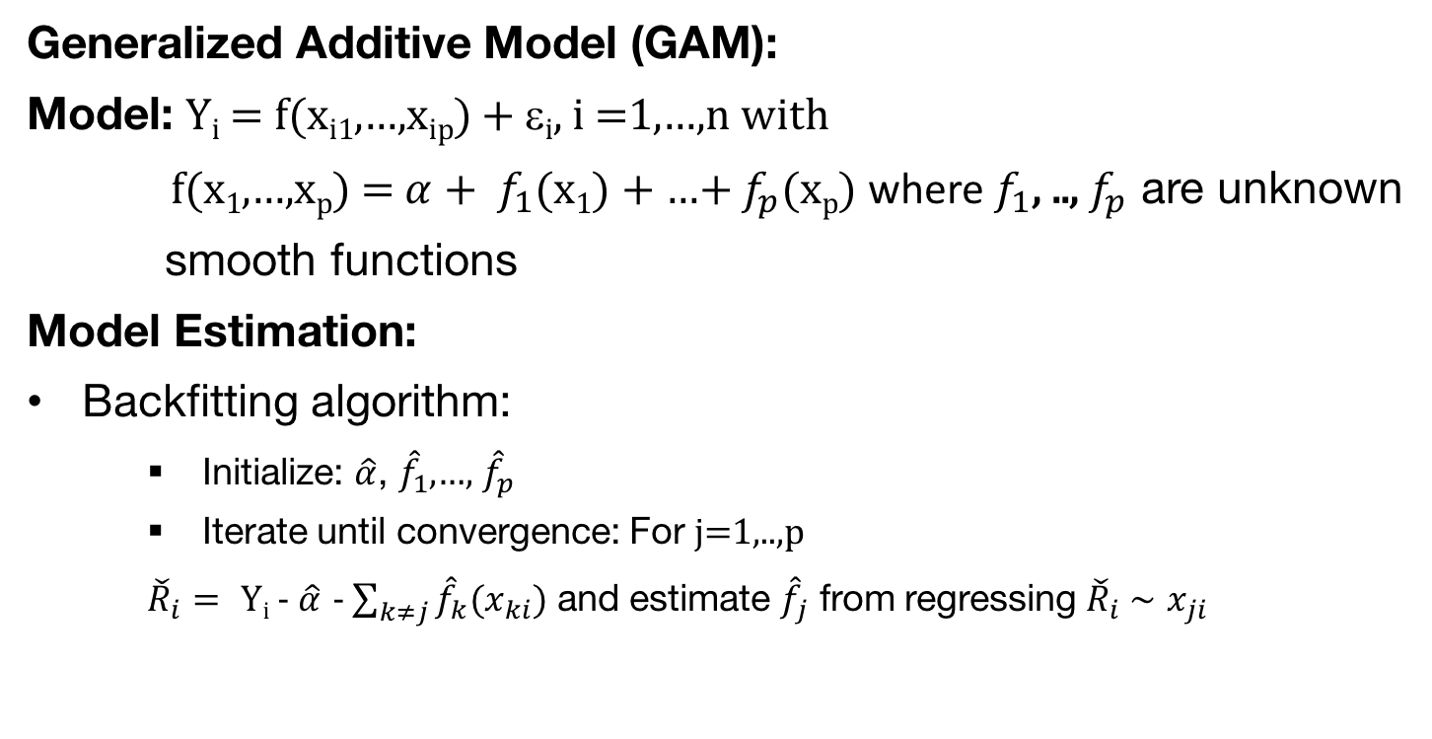
Nonparametric Regression (cont’d)
Generalized Additive Model (GAM):
Model: Y_{i} = f(x_{i1},…,x_{ip}) + ε_{i}, i =1,…,n with
f(x₁,…,x_{p}) = ${α+ f}_{1}$(x₁) + …+ $f_{p}$(x_{p}) where $f_{1}$, .., $f_{p}$ are unknown
smooth functions
Model Estimation:
Backfitting algorithm:
  Initialize: $\hat{α}$, ${\hat{f}}_{1}$,…, ${\hat{f}}_{p}$
  Iterate until convergence: For j=1,..,p
  ${\check{R}}_{i}=$ Y_{i} - $\hat{α}$ - $\sum_{k≠j}{{\hat{f}}_{k}(x_{ki})}$ and estimate ${\hat{f}}_{j}$ from regressing ${\check{R}}_{i} \sim$ $x_{ji}$
Nonparametric vs Linear Regression
The relationship of a predicting variable to the response is assumed unknown
Estimation using the least squares
Estimation of the parameters not in close form expression
R software: gam() in mgcv or gam library

Slide 8
Summary

